Slide 1
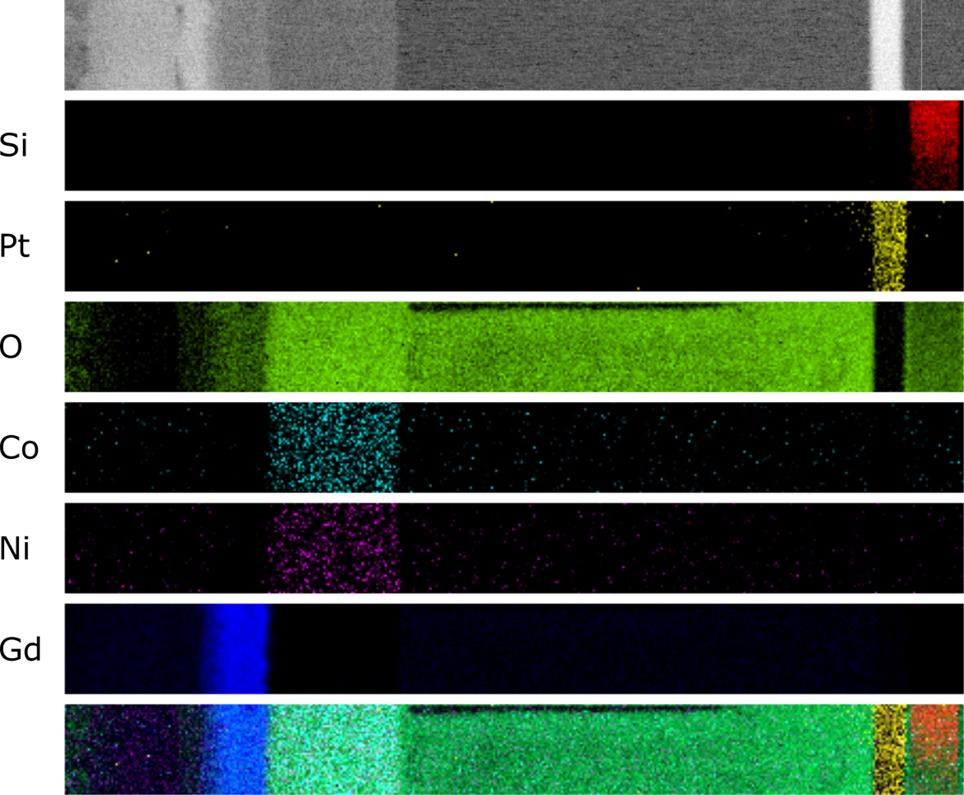
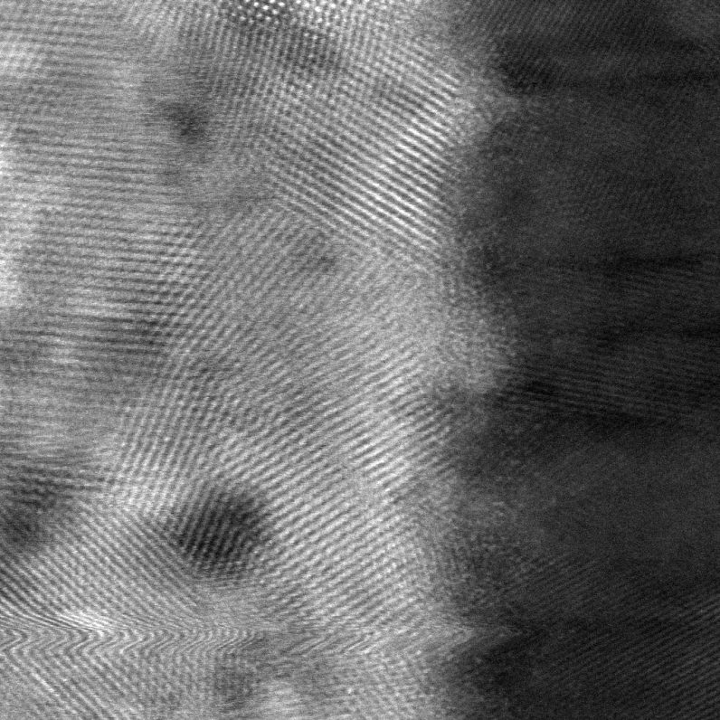
AG
50 nm
5 nm
size = 25 nm
size = _____ nm
0.71/3.62
Junwei, please fill in the blank lines with the size of the imaged region. I’ll add scale bars once I know how big each of these images is.

Slide 2
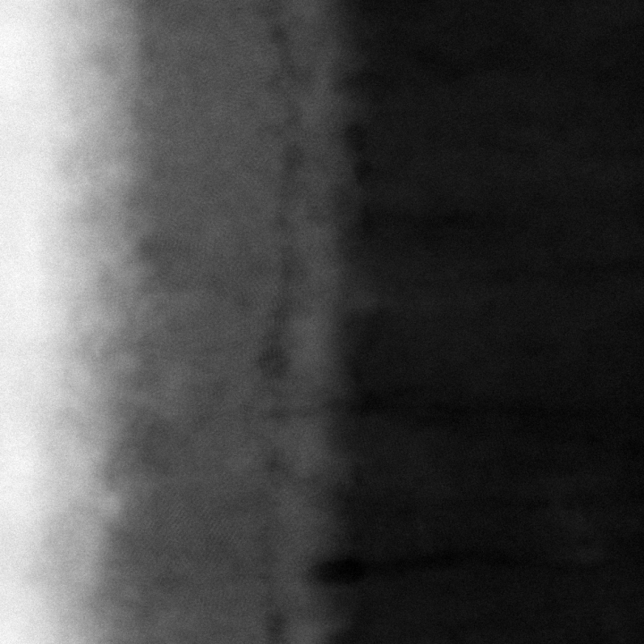
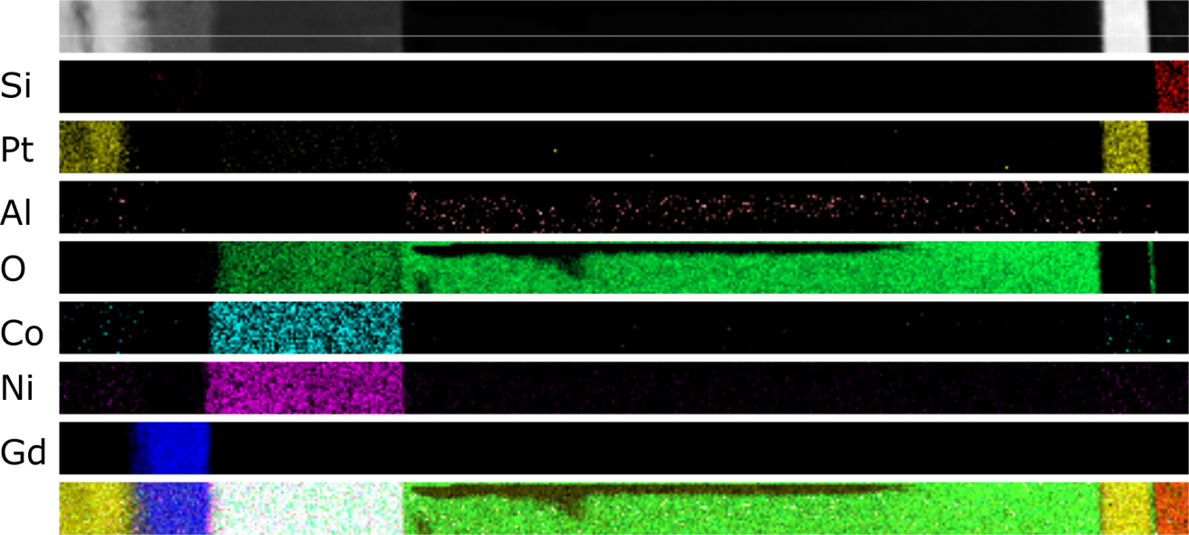
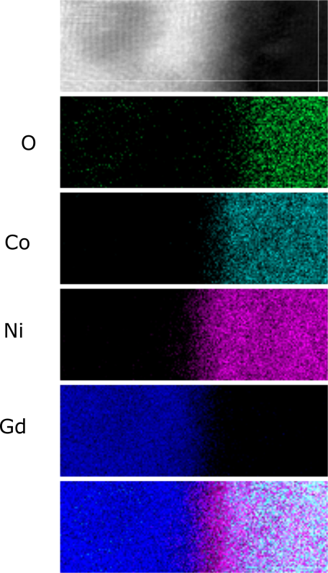
FC
50 nm
2 nm
10 nm
size = _____ nm
size = _____ nm
size = _____ nm

Slide 3
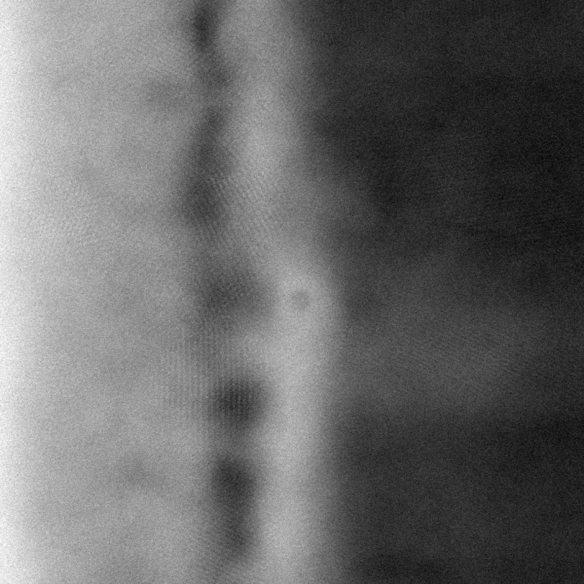
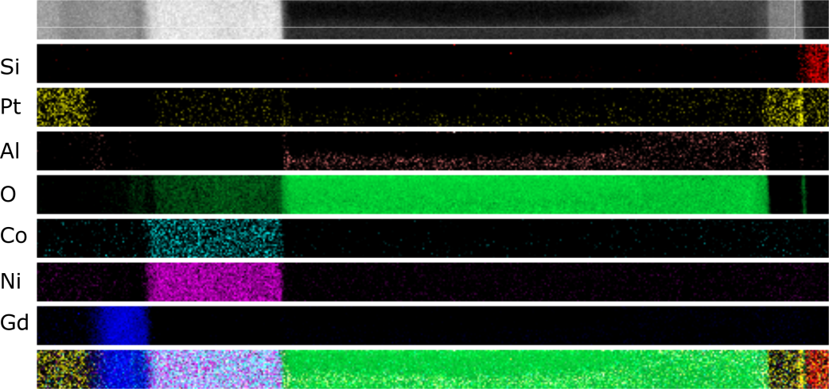
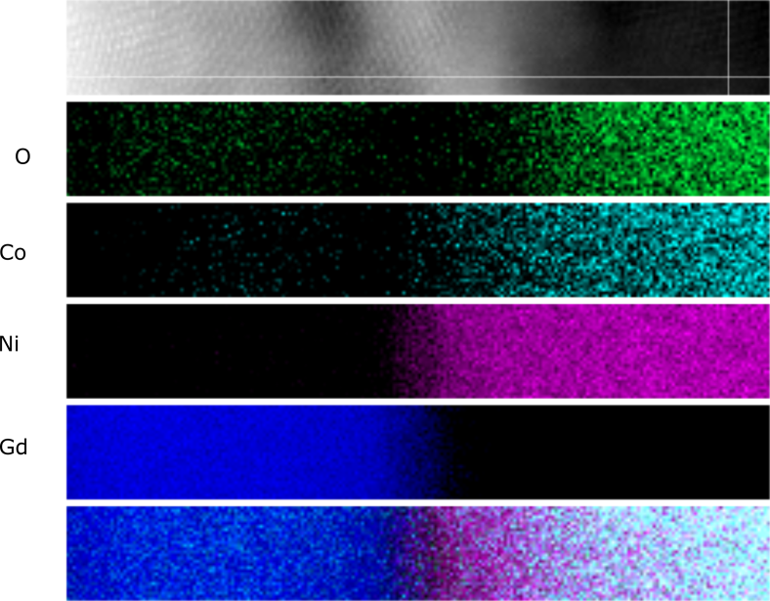
FCVC
50 nm
2 nm
10 nm
size = _____ nm
size = _____ nm
size = _____ nm

